Slide 1
DesignOptions in Applying Constraints
Steve Ray
steve@steveray.com
October 2, 2020

Slide 2
My example design approach
Parallel hierarchies
Hierarchy of “things” (devices, systems… - BRICK?)
Hierarchy of functions
So, if a thing performs some function, it acquires various relations and constraints by virtue of that function
A pressure sensor performs a pressure measuring function
Open question: Where to specialize?

Slide 3
Where to specialize (and constrain)?
Options:
Sensor class
Define a hierarchy of sensors, with associated constraints on what kinds of measurements they produce
Measuring function
Define a function hierarchy (including measuring), with constraints on what kinds of measurements they produce
Measurement class
Define a hierarchy of data (including measurements), with constraints on what kinds of measurements they produce
The example

Slide 4
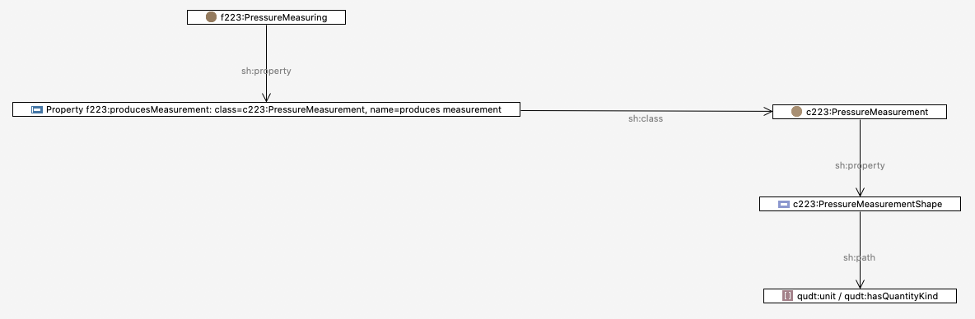
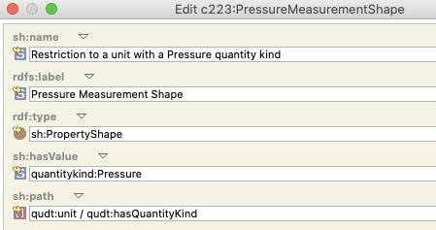
Where I applied measurement constraint
Functional hierarchy
Core model

Slide 5
Where to specialize (and constrain)?
Options:
Could do without a functional hierarchy altogether and use options 1 or 2 (constrain the device, or constrain the measurement)

